Slide 1
UNIT 2. part i. JAVA CONNECTORS FOR DATABASES.jdbc

Slide 2
LINKS
https://en.wikipedia.org/wiki/Object-relational_impedance_mismatch
http://www.ntu.edu.sg/home/ehchua/programming/java/jdbc_basic.html
https://docs.oracle.com/javase/tutorial/jdbc/basics/connecting.html
https://docs.oracle.com/javase/tutorial/jdbc/basics/sqldatasources.html
https://www.cis.upenn.edu/~bcpierce/courses/629/jdkdocs/guide/jdbc/getstart/intro.doc.html
https://www.protechtraining.com/content/java_fundamentals_tutorial-jdbc

Slide 3
Object-relational impedance mismatch
https://en.wikipedia.org/wiki/Object-relational_impedance_mismatch
Objects or class definitions must be mapped to database tables defined by a relational schema.
The properties of an object are stored in tables, where each column is independent from the others, while in an object the properties belong to one unique object.

Slide 4
CONNECTORS FOR RELATIONAL DATABASES
To access relational databases we can use 2 ways:
ODBC:Open Database Connectivity (ODBC) is a MS protocol that you can use to connect an application to an external data source such as SQL Server.
https://courses.cs.washington.edu/courses/cse444/04wi/project/support/odbc.html
https://www.dundas.com/support/learning/documentation/connect-to-data/how-to/connecting-to-odbc
JDBC: we will see this one in Unit2

Slide 5
1. Connection to database with Java
The interface for accessing relational databases from Java is Java Database Connectivity (JDBC). Via JDBC you create a connection to the database, issue database queries and update as well as receive the results.
JDBC provides an interface which allows you to perform SQL operations. To use JDBC, you require the database specific implementation of the JDBC driver (Oracle, MySQL, mariaDB,etc..).

Slide 6
Types of jdbc
There are 4 implementations of JDBC drivers.
Type 1: Drivers that implement the JDBC API as a mapping to another data access API, such as ODBC (Open Database Connectivity). Drivers of this type are generally dependent on a native library, which limits their portability. The JDBC-ODBC Bridge is an example of a Type 1 driver.
Type 2: Drivers that are written partly in the Java programming language and partly in native code. Again, because of the native code, their portability is limited.
Type 3: Drivers that use a pure Java client and communicate with a middleserver using a database-independent protocol. The server communicates the client's requests to the data source.
Type 4: Drivers that are pure Java and implement the network protocol for a specific data source. The client connects directly to the data source.➔WE WILL WORK WITH TYPE 4.

Slide 7
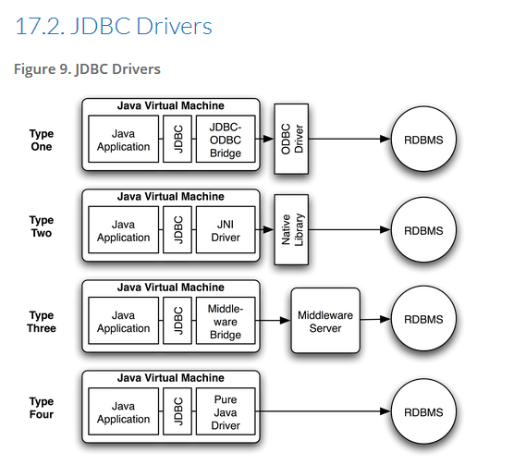

Slide 8
Steps to connect a jdbc and query
http://www.informit.com/articles/article.aspx?p=26251&seqNum=3
Import JDBC packages.
import java.sql.*;
Load and register the JDBC driver. Class.forName o DriverManager
Open a connection to the database.
Connection con = DriverManager.getConnection(URL, username, passwd);
Create a statement object to perform a query.
Statement sentencia=conexion.createStatement();
Execute the statement object and return a query resultset.
ResultSet resul=sentencia.executeQuery(="SELECT * FROM students");
Process the resultset.
while(resul.next()){
System.out.print(resul.getInt(1),resul.getString(2),resul.getString(3) );
}
Close the resultset and statement objects.
resul.close();
sentencia.close();
Close the connection.
conexion.close();

Slide 9
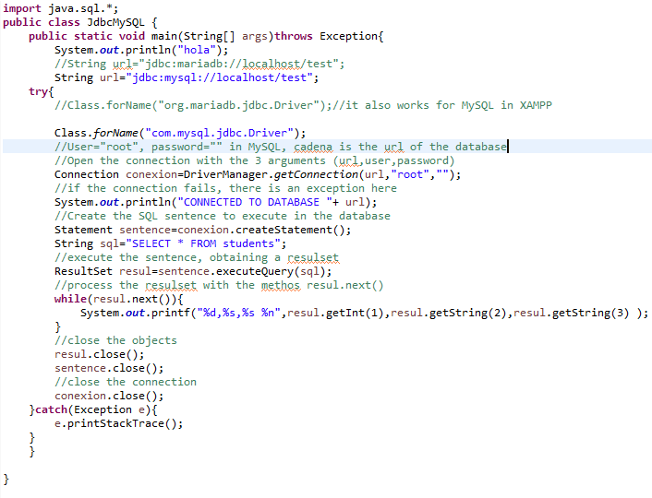
Jdbc example: connecting to mysql

Slide 10
Practice 2.1: use jdbc to connect a mysql database

